Slide 1
Diagnosis and Treatment of ADHD in Primary Care
Looking to create a cadre of primary care prescribers to give patients the medication they need

Slide 2
Personal investment
Partner at LHGP till 2017 - classic ASD masking meltdown
Went to my GP asking for an ADHD assessment in 2013
My appointment at SLAM arrived in 2019
Diagnosed privately Au-ADHD 2018 but it cost me £2000
Take 20 mg methylphenidate SR
really helps to slow my brain down
Asked my GP to increase the dose to 40mg. Told he would have to refer me – 6 months later I am still waiting for a secondary care appt
This is a crazy situation

Slide 3
ADHD presentations - Red Flags
• Organizational skill problems (time management difficulties, missed appointments, frequent late and unfinished projects).
• Erratic work/academic performance.
• Anger control problems.
• Family/marital problems.
• Difficulty in maintaining organized household routines, sleeping patterns and other self-regulating activities.
• Difficulty managing finances.
• Addictions such as substance use, compulsive shopping, sexual addiction, overeating, compulsive exercise, video gaming or gambling.
• Frequent accidents either through recklessness or inattention.
• Problems with driving (speeding tickets, serious accidents, license revoked).
• Having a direct relative who has ADHD. Treat the whole family
• Having to reduce course load, or having difficulty completing assignments in school. • Low self-esteem or chronic under-achievement.
Notes:
Patients who
Don’t stop talking
Move to the next problem without appreciating the first one you have just spent time sorting out
Generally rushed – no sense of peace or relaxation - intensity
Addictions not just alcohol drugs and sex but also eating 30 % of patients in obesity clinics have undiagnosed ADHD – runs a long a similar course
Addictions are a sign of lack of inhibition - just like talking all the time , cutting into conversations, jumping queues or being unable to queue up
More ASD
Unexplained job losses
Episodes of disadvantage - been kidnapped,
Never felt I fitted in
Don’t know what to say - cant make small talk

Slide 4
ADHD is a major problem
Adults with ADHD tend to suffer from major socioeconomic disadvantage functional impairment
and a diminished quality of life and reduced life expecetancy -worse than diabetes
Lower levels of education, higher levels of unemployment,
early parenthood
difficulties in governing financial issues.
ADHD is much more prevalent in the prison population and long term unemployed
Notes:
Adults with ADHD tend to suffer from major socioeconomic disadvantage ALSO Live fast, die young? A review on the developmental trajectories of ADHD across the lifespan - PMC (nih.gov)
[1], functional impairment
[2], and a diminished quality of life
[3–5]. Lower levels of education, higher levels of unemployment, and substance use, are known to be significantly associated with ADHD in adults [6].
Accidents [7],
early parenthood [8], and
difficulties in governing financial issues [9]
are thought to be more prevalent in adults with ADHD than in the general population.
ADHD is much more prevalent in the prison population compared with nondelinquent controls [10, 11]. As well as the long term unemployed
Among patients with ADHD, the rate of criminality is lower when they are receiving ADHD medication [12].
Life expectancy is 15 years less in the under 45 untreated group because of the increased accident rate
Treatment results in economic improvement for the state as well as the individual
The economic burden of adult attention deficit hyperactivity disorder: A sibling comparison cost analysis
D Daley ¹,
Adults with ADHD had considerably lower disposable income and paid less tax than their siblings. They also received more state benefits, had higher costs for health, social care, and crime than their siblings. The total average costs difference for the year 2010 was 20,134 euros more than their sibling for each adult with ADHD.
Conclusion: ADHD is associated with considerable costs which are borne by both the individual and the state and underlines the need to consider the wider economic impact of ADHD beyond income and healthcare utilisation costs.
Study: Living with ADHD Causes Significant Socioeconomic Burden
Living with ADHD poses a significant economic burden, according to a new study of the Australian population that found the annual social and economic cost of ADHD was $12.76 billion, with per person costs of $15,664 over a lifetime.
By Lilly ConstanceVerifiedUpdated on March 31, 2022
Click to Add Comments
SAVE
October 21, 2020
Living with ADHD may cost an individual $15,664 over a lifetime, and approximately $12.76 billion annually in the United States. This finding comes from a study published in the Journal of Attention Disorders¹ that attempted to comprehensively document the social and economic costs associated with attention deficit hyperactivity disorder (ADHD or ADD) using a lifespan approach. The study calculated financial costs across multiple domains, the largest of which was lost productivity.

Slide 5
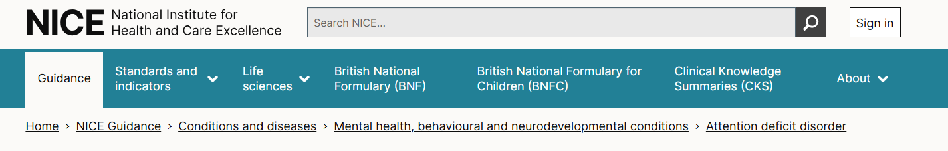


Slide 6
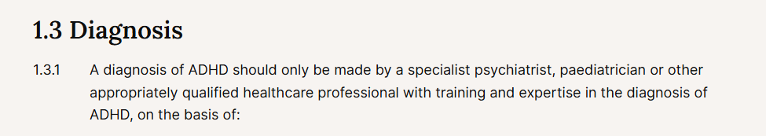
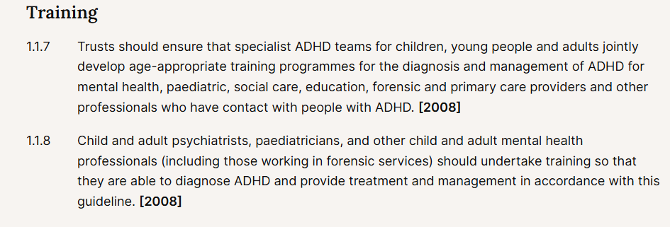
NICE - adults:

Slide 7
Lets get real
  Easy to diagnose in primary care
  The treatment is safe
  Very satisfying both for the GP and the patient
  Prevalence of untreated ADHD patients is such that it can only successfully be managed in primary care

Slide 8
ADHD diagnosis - 1 – definitions
DSM 5 and ICD-11
5 symptoms from a list of 9: 5/9 :hyperactive ADHD: 5/9 inattention ADHD or 5/9 +5/9: Combined ADHD
• Age of onset of these symptoms is by age 12. •
Impairment in two or more roles due to these symptoms has been present for the last six months or more. •
A lack of alternate explanation for the symptoms or impairment, including a broad range of alternate medical (including mental health) and circumstantial
Notes:
Principles for Assessment and Diagnosis 1. The clinician has to be fully licensed
and adequately trained in order to ensure Diagnostic and Statistical Manual, Fifth Edition (DSM-5) diagnostic criteria for ADHD are fully met [1].
2. The assessment needs to reflect an understanding of multi-systemic issues that may confound or complicate the ADHD diagnosis (e.g., the educational/vocational, psychosocial, psychiatric and medical interfaces).
3. Symptoms and functional impairment need to be assessed. Using valid, reliable and sensitive instruments helps to evaluate frequency, severity, and outcome.
4. Regular documentation of symptoms and functional impairment, if possible at each visit, helps to track progress and monitor outcome.
5. Establishing collaborative treatment goals with the patient (and their family when appropriate) ensures that outcomes are patient-centered. 6. The results of the assessment need to be communicated to the patient and their family with clarity and compassion.
Rating scales and questionnaires can be used, but are not sufficient for a diagnosis as other conditions may screen positive on ADHD rating scales (e.g. overlapping symptoms of depression or anxiety, or the presence of medical conditions like sleep apnea or anemia). These instruments, however, are effective screening tools and can be employed to document change over time and track treatment effects.
Neuropsychological testing should not be used they do not accurately measure the nature of “real world” cognitive or academic impairments that characterize ADHD.
Computerized cognitive assessments (e.g. Conners’ Continuous Performance Test, Test of Variables of Attention, Gordon Diagnostic
Table 1.1 Diagnostic and Statistical Manual Fifth Edition (DSM-5) ADHD Symptom Criteria Criteria
A1 Inattention Symptoms Criteria A2 Hyperactive-Impulsive Symptoms
1. Often fails to give close attention to details or makes careless mistakes in school work Often fidgets with hands or feet or squirms in seat
2. Often has difficulty sustaining attention in tasks or play activities Often leaves seat in classroom when remaining seated is expected
3. Often does not seem to listen when spoken to directly Often runs about or climbs excessively in situations where it is inappropriate
4. Often does not follow through on instructions and fails to finish school work Often has difficulty playing or engaging in leisure activities quietly
5. Often has difficulty organizing tasks and activities Often is "on the go" or often acts as if "driven by a motor"
6. Often avoids, dislikes, or reluctantly engages in tasks requiring sustained mental effort Often talks excessively
7. Often loses things necessary for activities (e.g. school assignments, pencils, or books) Often blurts out answers to questions before the questions have been completed
8. Often is distracted by extraneous stimuli Often has difficulty awaiting turn
9. Often is forgetful in daily activities Often interrupts or intrudes on others (e.g. butts into conversations/games

Slide 9
ADHD Diagnosis 2 – Rating Scales
Diva 5 – Psychiatrists favourite but takes 3 hours
ASRS - Over sensitive ADHD screening tool
Wellbeing - Weiss
PHQ 8 - depression
GAD 7 – Anxiety
Notes:
Note: Overall psychiatric health should always be considered and a risk assessment done at the onset. There are several tools available to assist in the diagnosis of mental health problems. Examples of these general screeners are the Weiss Symptom Record (WSR)[26], the Patient Health Questionnaire (PHQ-9)[27] and the Generalized Anxiety Disorder Item-7 (GAD-7)[28] as well as the Screen for Child Anxiety Related Disorders (SCARED)[29] and the Kutcher Adolescent Depression Scale (KADS)[30]. As always, therapeutic decisions should be based on a thorough evaluation of the patient with the most prominent or critical issues addressed first. This chapter provides information on how to systematically assess patients with ADHDconsistent features.
A2 Hyperactive-Impulsive Symptoms
Often fidgets with hands or feet or squirms in seat
2. Often has difficulty sustaining attention in tasks or play activities Often leaves seat in classroom when remaining seated is expected
3. Often does not seem to listen when spoken to directly Often runs about or climbs excessively in situations where it is inappropriate
4. Often does not follow through on instructions and fails to finish school work Often has difficulty playing or engaging in leisure activities quietly
5. Often has difficulty organizing tasks and activities Often is "on the go" or often acts as if "driven by a motor"
6. Often avoids, dislikes, or reluctantly engages in tasks requiring sustained mental effort Often talks excessively
7. Often loses things necessary for activities (e.g. school assignments, pencils, or books) Often blurts out answers to questions before the questions have been completed
8. Often is distracted by extraneous stimuli Often has difficulty awaiting turn
9. Often is forgetful in daily activities Often interrupts or intrudes on others (e.g. butts into conversations/games)

Slide 10
ADHD – comorbidities 1
Usually occurs in conjunction with other illnesses This is normal not the exception
In ADHD patients
30% will have anxiety and 30% depression
Up to 30 % will have ASD
30 % BPD,
30 % a learning disability
20% Conduct disorder esp in children, substance misuse in adolescents
20% bipolar
Notes:
Every GP needs to be aware of all these psychiatric conditions in case they are the dominant condition and will require treatment before the ADHD can be tackled
Over the course of years, tic severity typically peaks between 8 and 12 years of age. The natural history of tics usually shows a marked decline during adolescence (Cohen et al., 2013). Population studies suggest that intellectual disability may be more common (up to 5–10 times) in ADHD than in children without ADHD (Simonoff et al., 2007). About 25–40% of all patients with ADHD have major reading and writing difficulties, and many show co-existing language disorders (Sciberras et al., 2014, Willcutt et al., 2012). Similarly, there is a considerable overlap between ADHD and disorders of arithmetical skills (Hart et al., 2010, Rapport et al., 1999). As for ASD, hardly any information is yet available on the lifespan trajectories of ADHD with such comorbidities.
Looked at from the other side, in adult patients suffering from alcohol abuse, 30–70% suffered from childhood ADHD, and 15–25% still displayed the disorder as adults.

Slide 11
Co morbidities – 2 ADHD found in psychiatric clinics
Prevalence of ADHD in nonpsychotic adult psychiatric care (ADPSYC): A multinational cross-sectional study in Europe
Walter Deberdt, et al
Up to 20 % of patients seen in clinic have undiagnosed ADHD

Slide 12
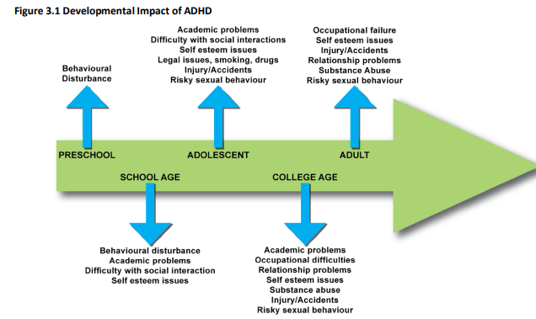
ADHD across the Lifespan

Slide 13
Other issues
Accidents and risks
Driving
Brain damage – accidents – less responsive to Rx
Notes:
In terms of mortality, several studies from Scandinavia have explored the association of ADHD with mortality and which factors are likely to increase mortality. These studies have used information from national registers in Sweden and Denmark that have been linked using a unique person identifier. A Danish register-based study has found that ADHD is associated with significantly increased mortality rates, and that the excess mortality in ADHD is mainly driven by deaths from unnatural causes, especially accidents (Dalsgaard et al., 2015b). Other register-based studies have confirmed that individuals with ADHD are at increased risk for serious transport accidents (Chang et al., 2014a), and also show increases in criminality (Dalsgaard et al., 2013, Lichtenstein et al., 2012) and suicidal behaviour (Ljung et al., 2014), which are severe negative outcomes in their own right and could contribute to the increased mortality.
Old age is the current blind spot of ADHD research, which has to be factored in when interpreting all the data presented above. This lack of knowledge limits the possibility to perform a review of the complete lifespan, as most available studies deal with ADHD in children – even 50 years after the first studies showed that ADHD also exists in adults and can continue from childhood to adulthood (Wood et al., 1976). Beyond mid-adulthood, hardly any information on ADHD can be found.
In conclusion, ADHD is the prototypic example of a neurodevelopmental disorder starting early in life and developing with a highly variable trajectory. While in some cases it might be the entry point into a negative, burdensome trajectory, other patients may remit and even transform some deficits into adaptive behaviours, living highly successful lives. The latter suggests that there is potential for improvement in many ADHD patients, if recognised early on and receiving optimal treatment. To clarify the course, to identify those at risk of unfavourable outcome and to provide tailored treatment, longitudinal, granular, and multimodal studies are clearly needed. While we appreciate that this poses a challenge, we are confident that such an endeavour would – just like the fight against HIV three decades ago – pay off in every respect to improve the life of many patients.
Children admitted to hospitals due to accidental injuries are three times more likely to have ADHD (approx. 30%) than are children admitted for other reasons. Factors that have been associated with these elevated risks are inattention, impulsivity and risk-taking behaviours, motor incoordination, comorbidity with ODD/CD, anxiety, and depression, and parental characteristics such as reduced parental monitoring of the child's activities. Medication can decrease injuries [87].
Adolescents
Sexual activity starts for some during adolescence. Both male and female adolescents who have ADHD are at increased risk for early sexual activity, sexual transmitted diseases and multiple sexual partners [314]. Females with ADHD are at risk of higher rates of teenage pregnancy compared to adolescents without ADHD [314, 315]. Information should be provided about risky sexual activities and use of birth control methods should be encouraged where appropriate. Adolescence is frequently the time where experimentation with alcohol and drugs begins. Adolescents with ADHD have higher risk than the general population to start using earlier and to develop more severe difficulties with substances [131]. Comorbidity of ADHD and SUD commonly starts in adolescence [316]

Slide 14
Treatment - Psychosocial
Individual
Environmental – school and workplace
Notes:
Important and as you can see I hiave deveoted a whole slilde to it
But I am not going to focus on it because many other people and agencies can supply this sort of support and there is ample evidence that society as a whole is not prepared or organsied to support individuals over the long term
And it needs to be
But lessons learnt from studying this aspect of the disease management are very important to being a holistic clinician and many of the interventions can help individuals who are not reaching a medication threshold

Slide 15
Treatment - medication
Medication
Key element of what we can add This is what prescribers are for and medication is the single biggest treatment benefit we as prescribers can offer
No age specific criteria and no max age
Pregnancy – unknown but is done with specialist advice
Children can be treated from 5 or sometimes younger
Notes:
In terms of drug treatment side effects, the most typical are decreased appetite, sleep disturbance, headaches, drowsiness, tearfulness, abdominal discomfort, nausea and vomiting, irritability, mood changes, constipation, fatigue, sedation, and increased blood pressure and pulse. Delays in height and weight are relatively minor with stimulants, often appear to attenuate with time, and seem not to affect ultimate height and weight in adulthood (Fredriksen et al., 2013). The cardiovascular safety of stimulant medications and atomoxetine has been a subject of debate over many years. It is quite surprising that this controversy occurs for drugs such as methylphenidate, which have been on the market for over 50 years. Cohort studies, however, did not find an increase in serious cardiovascular events following ADHD medications in children or adults, although both stimulants and atomoxetine were found associated with slight increases in heart rate and blood pressure (Cooper et al., 2011).
Public concerns that stimulant treatment in childhood and adolescence may increase SUDs in adulthood seem unsubstantiated.

Slide 16
Medication 2
First line Stimulants
Second line non stimulants
Third line - Rare ones
Excellent advice about when in the day to start and how long the drug effect is wanted for are in the CADDRA guidelines
Treat the most severe co morbidity first
Blood pressure rising is the most significant side effect to monitor for

Slide 17
Medication 3
The real precautions
Bipolar
Cardiac disease
Psychosis
Pregnancy and lactation
Contraindications
Allergy
MAOI within 14 days
Notes:
Stimulants
Hyperthyroidism
Phaechromocytoma
Uncontrolled HT
History of mania or psychosis
Precautions
History of substance abuse • Anxiety1 • Renal impairment • Tic disorders2 • Epilepsy • Peripheral vasculopathy including Raynaud’s Phenomenon
Monitoring
• BP, HR (may increase) • Priapism • Growth retardation • Peripheral vasculopathy including Raynaud’s Phenomenon
Atomoxetine
Astham
Raynoulds and PVD
Monitoring P{riprism
Liver
Grwoth 9 Usually recovers in adulthood reaches max predicted )

Slide 18
Medication specifics – 4 – Stimulants
Amazing High response rate
Safe
Long acting – safer and better compliance
Are
Des Lis Amphetamine – Elvance
Methylphenidate – Concerta, Medikinet el al Capsules 20 mg and tabs 18mg
Notes:
Great Chart
adhd-medications---a-guide-for-healthcare-professionals.pdf (cambscommunityservices.nhs.uk)

Slide 19
Medication specifics
adhd-medications---a-guide-for-healthcare-professionals.pdf (cambscommunityservices.nhs.uk)

Slide 20
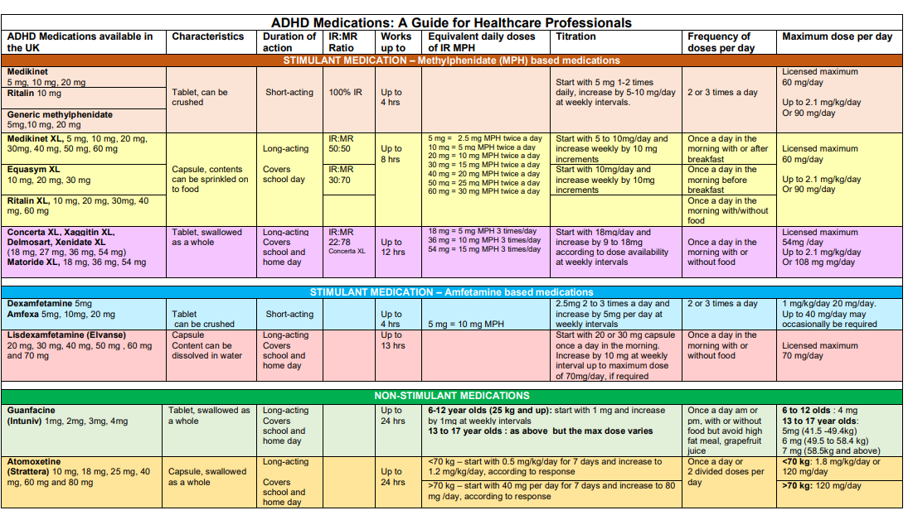

Slide 21
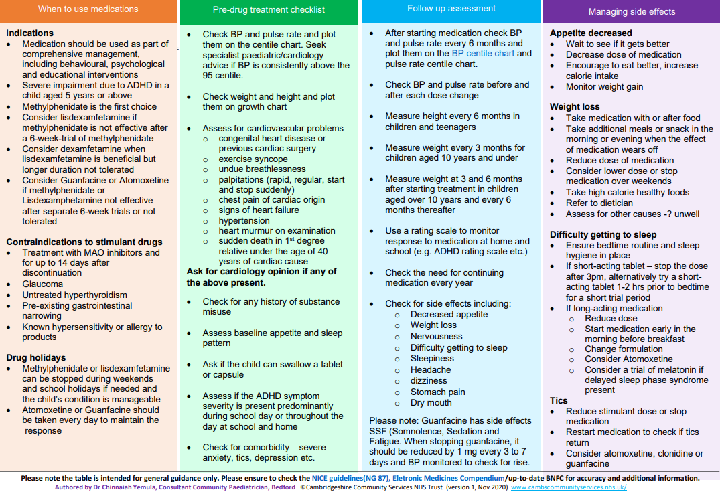

Slide 22
Medication – Dose adjustment
Drud | Start | Increase by | Max dose
Concerta XL (13 hrs) | 18mg | 9mg/ 18mg | 54mg
Elvanse/Vyvanse lisdexamfetamine 12 hours | 20 or 30 mg | 10 ( WEEKLY) | 70

Slide 23
Medication - 5 - reviews
Ht and Wt and BP 3 – 6 monthly - mostly done by ARRS prescribing team and could be trained up to do mediation initiation and dose changes
Annual review

Slide 24
Medication Myths
Addiction
Diversion
Crushing up for a high
It is a CD –this causes concern with some GP – but we prescribe CDs nearly every day ?

Slide 25
Summary
ADHD is easy in 90% of cases
ADHD should be diagnosed and treated in primary care
  Prevalence
  Chronic life long condition ideally suited to primary care
Medication is highly effective in correct patients
If you want to get on with training and treating patients – look at
CADDRA.ca
ADHDbyGP.org

Slide 26
The END - and
The Beginning
Notes:
Caddra
UKAAN
RCGP
ADHD by GP
NASGP
Me

Slide 27
Numbers - South West London
Population Adults 977 000
​Estimated ADHD Adults (3.5% ) = 34 000
Treated Adults (18 %) = 6 000
Untreated Adults (82%) = 27 000
Number of Primary Care Networks = 39
Number of GPs we would like to train = 80
Notes:
Estimated ADHD Children (5%) =12 000
Treated Children (23%) = 2 800
Untreated Children (77%) = 9 400
Estimated ADHD Children (5%) =12 000
Treated Children (23%) = 2 800
Untreated Children (77%) = 9 400
​
​

Slide 28
Plan
See 50 % of undiagnosed patients
Over a 5 year period
Each PCN would need to provide a GP for a day and a half a week
to eliminate the waiting list
Money - its there –
The RTC providers are getting thousands of referrals from across the UK and getting paid. About £1000 for diagnosis and more for med reviews

Slide 29


Slide 30
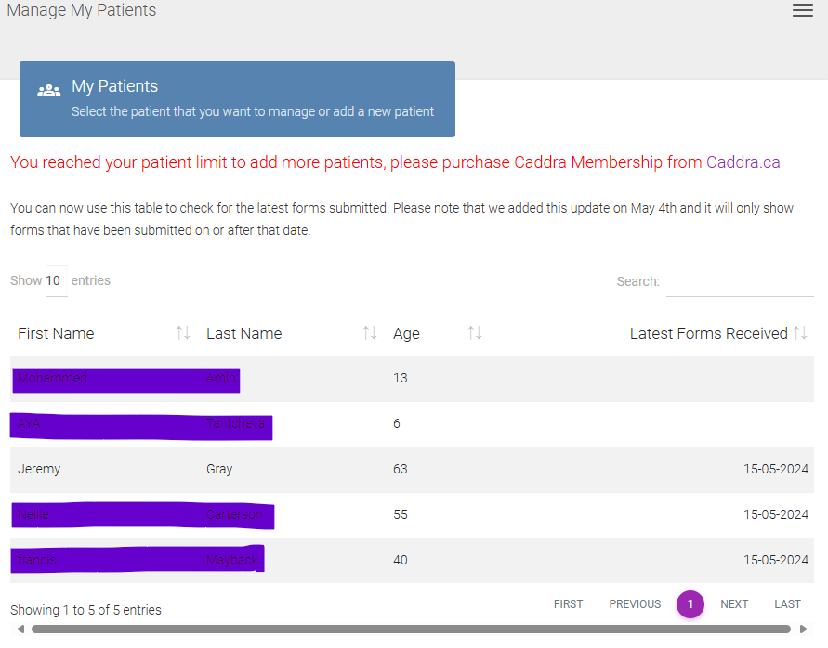

Slide 31
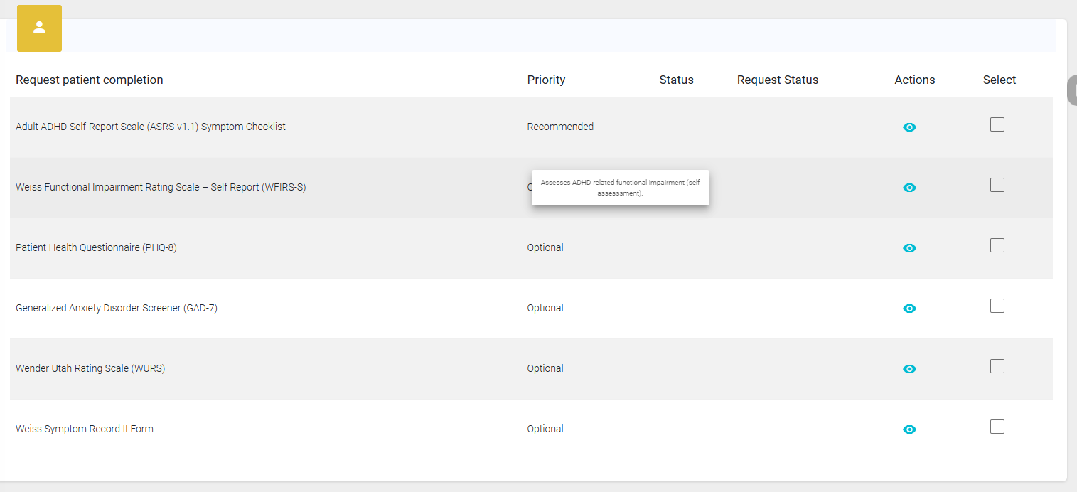

Slide 32
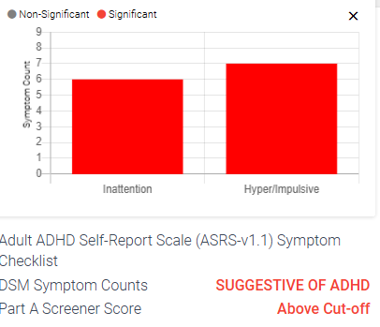
ASRS

Slide 33
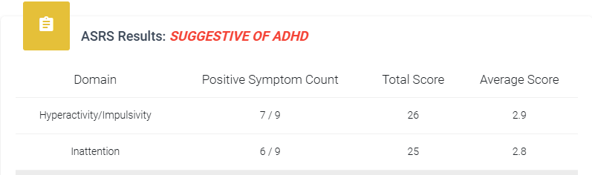
ASRS detail

Slide 34
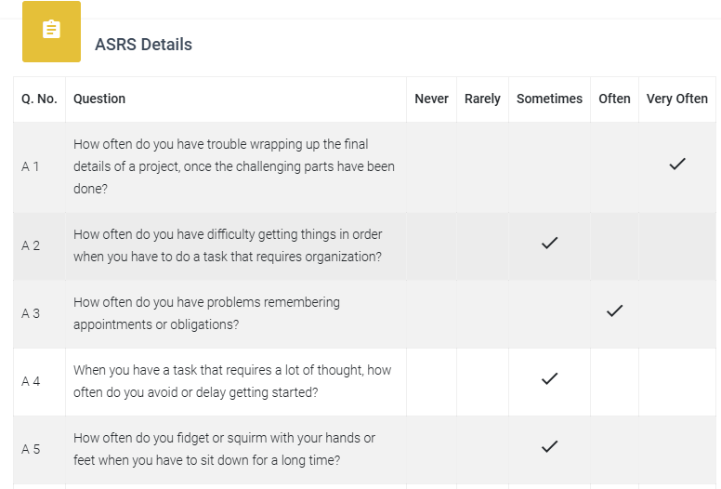
ASRS detail

Slide 35
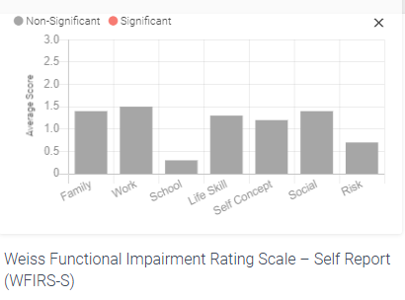
Weiss Impairment Scale

Slide 36
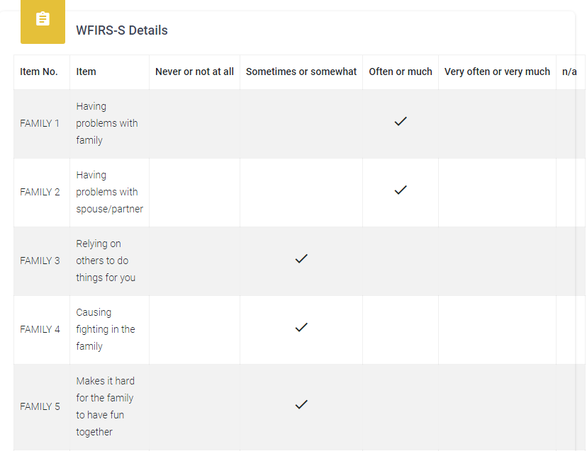
Weiss Impairment Scale

Slide 37
We need supervision
For our first cases
For ongoing mentoring and support
As NICE guidance says – Should come from our local trust
Maybe it will – discussions are just starting

Slide 38
GPs as independent contractors
We can be employees of the mental health trust
Or we can be independent experts based on our training
Both general – experience of mental health diagnoses
And specific after specific ADHD training -

Slide 39

If you are interested: visit ADHD by GP.org

Slide 40
Inaugural meeting London GP group
Friday 7pm. 7th June 2024
Join Zoom Meeting
https://us02web.zoom.us/j/81720128897?pwd=eFNzbzBKSm9hRHRwb3BPWU11bG1LZz09
Meeting ID: 817 2012 8897 Passcode: 999469
jeremygray@nhs.net

